Slide 1
US Income Classification Assignment-3
-Team 9
Ayushi Srivastava
Bhavesh Patel
Ila Nigam

Slide 2
Data set
In the census data every record represents a person with 14 attributes, the last element of a record is one of the labels {>=50K,<50K}.
Age: continuous
Workclass: 8 values
Education: 16 values
Education-num: continuous.
Marital-status: 7 values
Occupation: 14 values
Relationship: 6 values
Race: 5 values
Sex: Male, Female
Capital-gain: continuous.
Capital-loss: continuous.
Hours-per-week: continuous.
Native-country: 41 values
>50K Income: Yes, No

Slide 3
Business Problem
Q1. Which of the variables (age, occupation, sex, etc.) are most decisive for determining the income of a person?
Q2. Which values for which variables form conditions that would imply high income or low income?
Q3. What percentage of people of which race, Occupation, Education, Age, status can afford what kind of Standard of living
Patterns in Data Set
Age vs Job- younger people tend to work in the private sector while older people work for the local government or are self employed
Age vs Number of Years In School- older a person is, the more likely he/she is to have a greater number of years of education
50K vs School Level- people who finish college are significantly more likely to earn over 50K

Slide 4
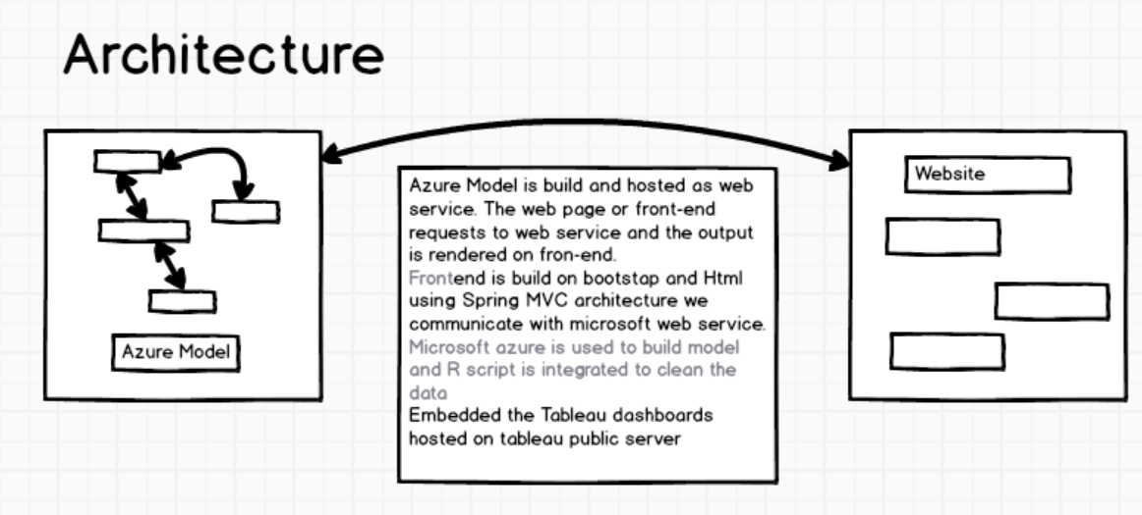
Architecture

Slide 5
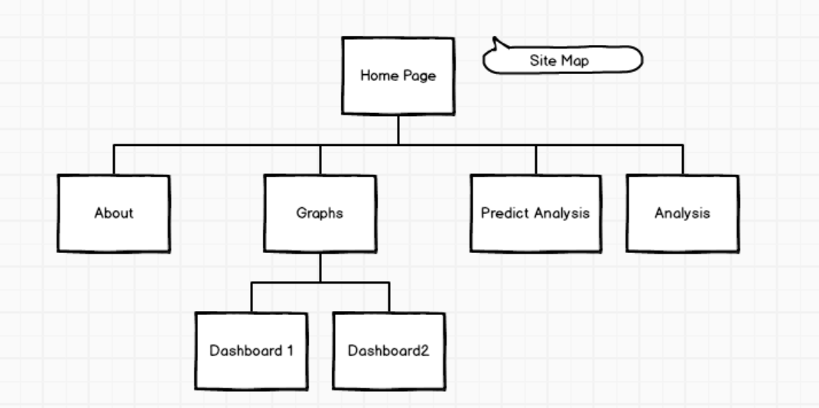
UI- MOCKUP using Tool

Slide 6
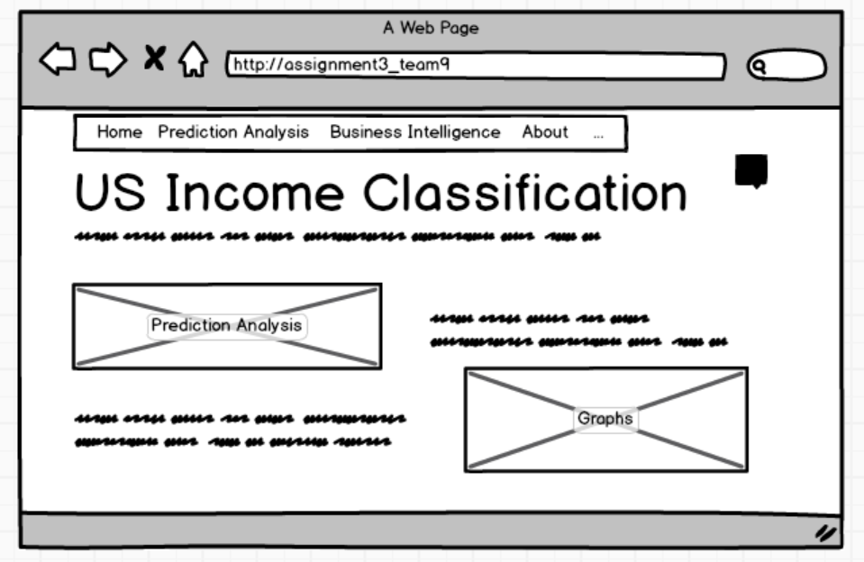

Slide 7
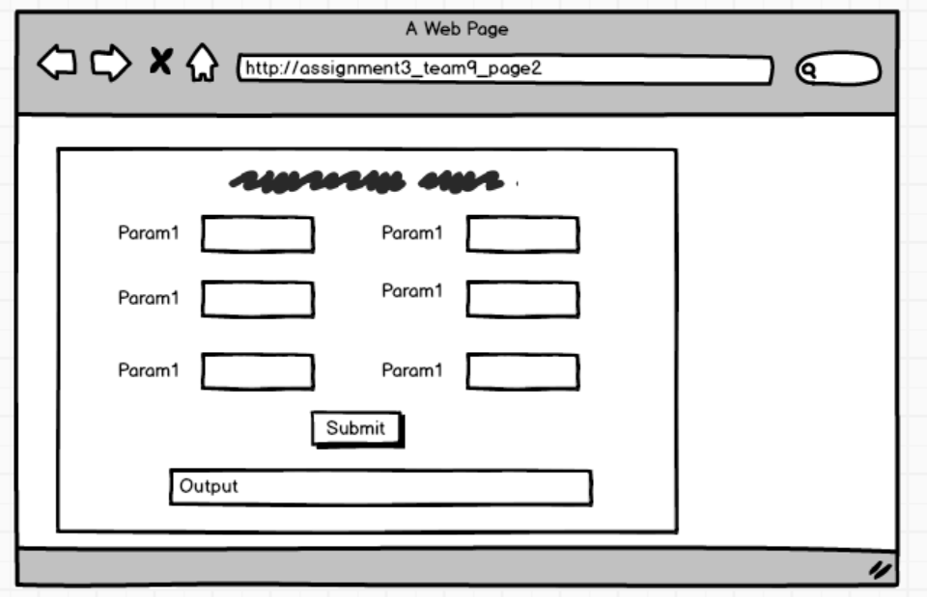

Slide 8
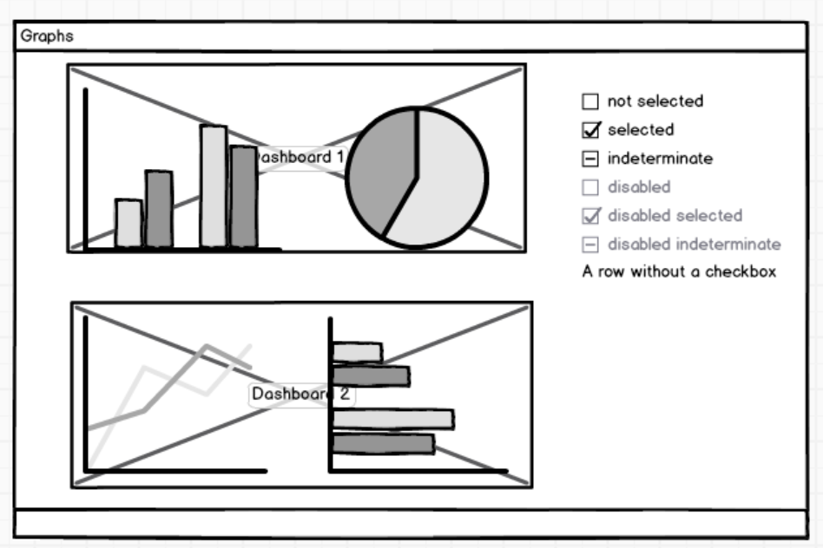

Slide 9
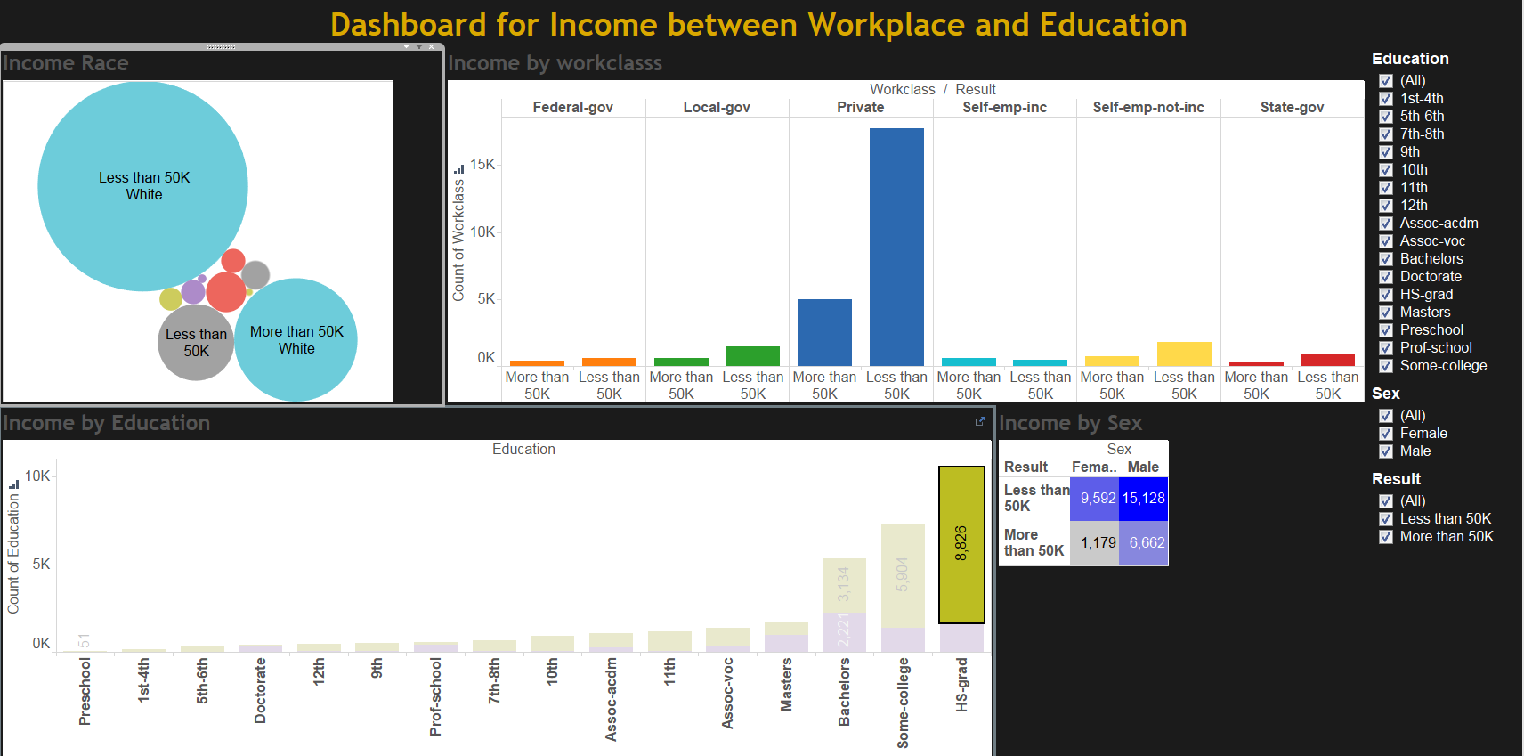
Tableau Visualization

Slide 10
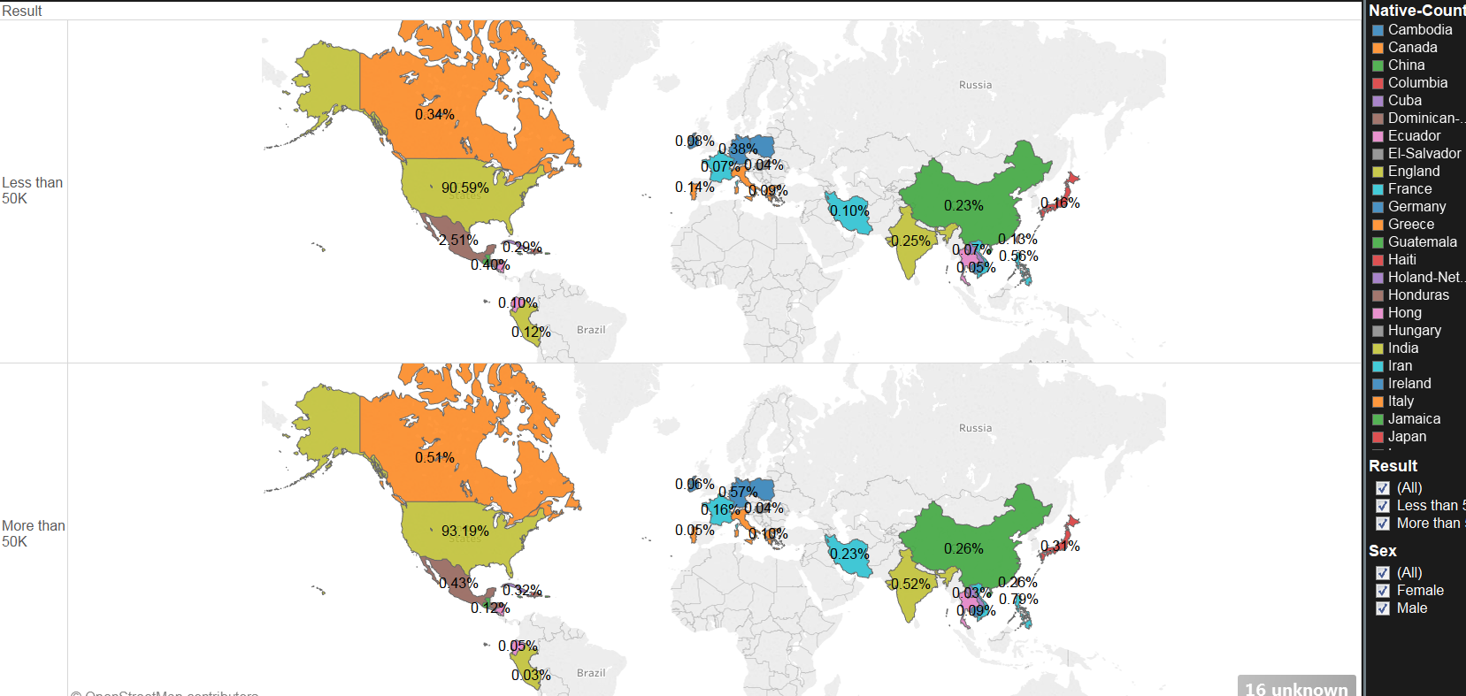
Tableau Visualization

Slide 11
Algorithms
We build following algorithms to solve above problem
1. Two - class boosted Decision Tree
2. Two - class Decision Jungle
3. Two - class Logistic Regression
4. Two – class Neural Network
5. Two – class Decision Forest

Slide 12
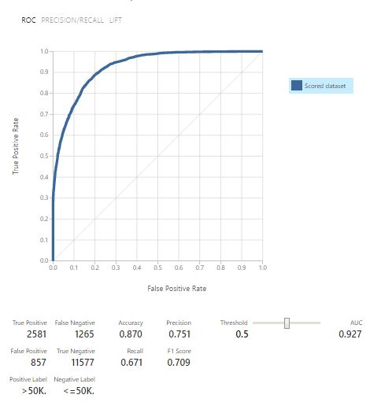
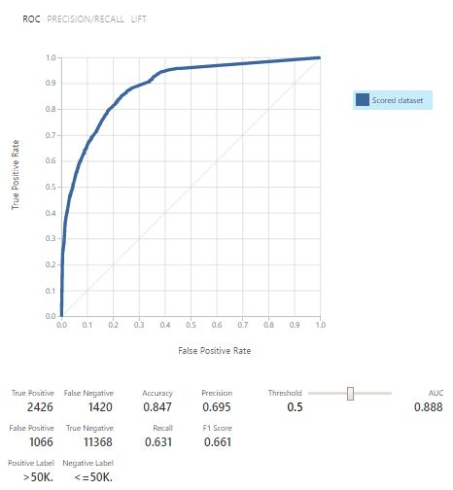
ROC Curve
Boosted Decision Tree
Decision Forest

Slide 13
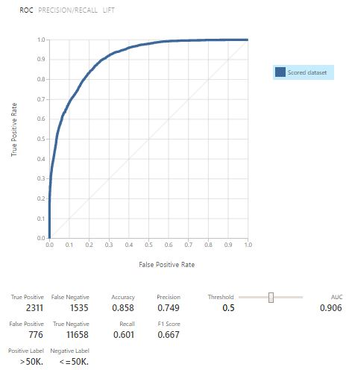
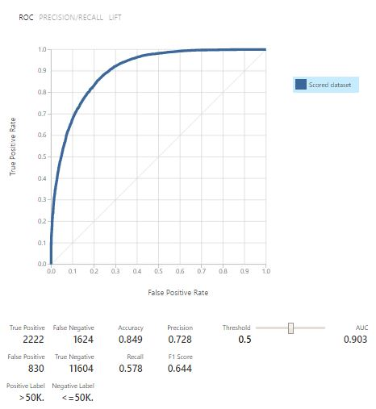
ROC Curve
Decision Jungle
Logistic Regression

Slide 14
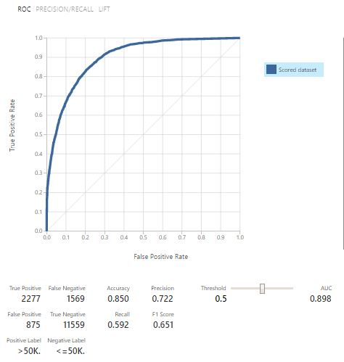
ROC Curve
Neural Network

Slide 15
Conclusion
All the algorithms were evaluated and Two-Class Boosted Tree was found to be best with 87% accuracy
Two-class Boosted Algorithm was used to deploy the web service and classification analysis uses this model in the web application

Slide 16
Platform Used
Microsoft Azure:
https://ussouthcentral.services.azureml.net/workspaces/855d6eb6f36e47eeaebfc6a8241e7cf2/services/a2159cb8885a4d94887ee0b04094baa7/execute?api-version=2.0&details=true
AWS domain:
http://census-env-new.us-west-2.elasticbeanstalk.com
Tableau Dashboard:
https://public.tableau.com/views/Assignment3_128/IncomebyNativeCountry?:embed=y&:display_count=yes
https://public.tableau.com/views/Assignment3_128/DashboardfprIncomebetweenWorkplaceandEducation?:embed=y&:display_count=yes

Slide 17
Thank you..

